Slide 1
VIH Mentoring Program: Relationship Building

Slide 2
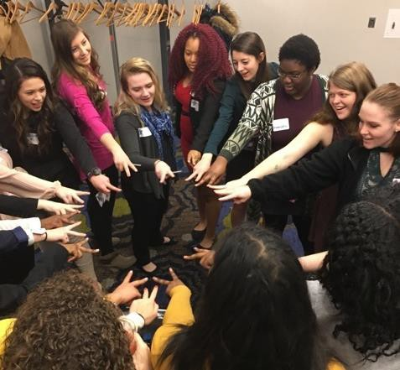
During the Retreats…
The retreats are a great time to connect with fellow cohort members embarking on similar experiences. Some people thrive in environments with new people, however, others may become overwhelmed. Mentee, what is your typical response to meeting a large new group?
Mentor:
Describe your approach to interacting with fellow cohort members at the retreats.
Share any tips you have with your mentee
Mentee:
After hearing about group dynamics at the retreat, what is your strategy to maximize relationship building?

Slide 3
Working with Your Campus Coordinator
They are an excellent resource to reach out to!
Mentor:
Describe your approach to developing a relationship with your campus coordinator. How did you take initiative towards gaining marketing hours? What could you do better and what will you do differently in the future?
Mentee:
What is your strategy to develop a robust relationship with your campus coordinator?

Slide 4
Communication: Don’ts
Hey Campus Coordinator,
I am actually not sure if I will have time to meet to review the experience report before it is due. Maybe I can send it to you by next week?
-Student
Mentor and Mentee: Discuss what makes this e-mail ineffective. What could you do to improve this e-mail?

Slide 5
Communication: Dos
Dear Campus Coordinator,
I am looking forward to meeting and working with you as I move forward in my VIH experience! I have some revisions I would like to make to my current draft of my experience report, so I can send it to you by this coming Tuesday. I would like to schedule a time to meet next week and discuss my experience report. I am available the following dates and times:
Tuesday: 11am-12pm or 2pm-3pm Wednesday: 9am-11am or 3pm-4pm Friday: 10am-12pm or 1pm-3pm
Please let me know if any of the above times work with your schedule to meet with me.
Best, Student
Mentor and Mentee: Discuss what makes this e-mail effective.

Slide 6
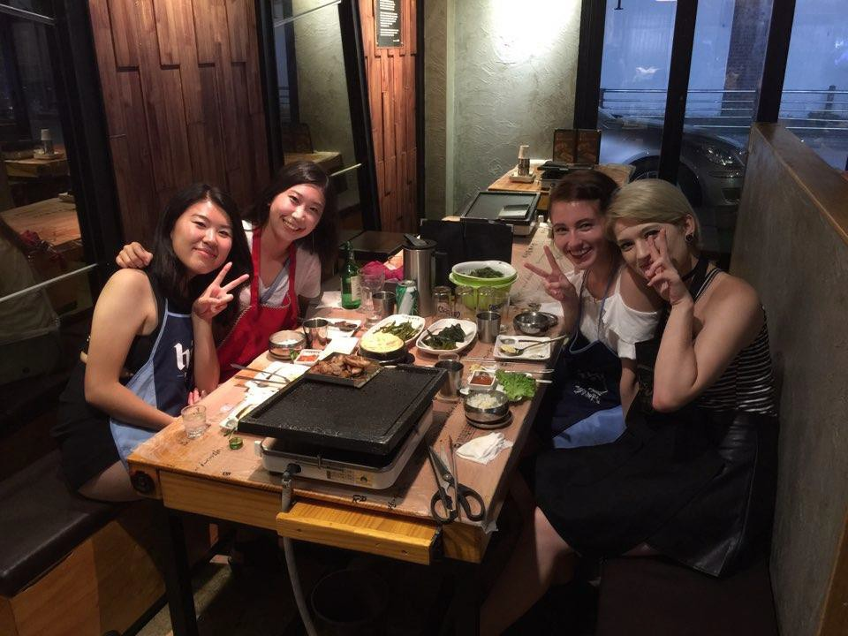
International Experience
Meet new people– both locals and other
students who are studying abroad
Mentor:
Describe your approach to developing a relationships abroad. What worked well? What would you do differently if you could do it again?
Mentee:
What are three things that you will do to develop relationships abroad?

Slide 7
Community Engagement Experience (CEE)
Collaborate with community members, cohort members, and your Campus Coordinator
Mentor:
What was your CEE? What did it look like?
How did you use your CEE as an opportunity to expand your network?
What advice do you have for your mentee?

Slide 8
Beyond the Retreats
Mentor: Explain your strategy on staying active within the VIH Network
Other tips:
Connect with VIH on LinkedIn, Facebook, Instagram, and Twitter
Send emails to your campus coordinator, the program director, and your fellow Viras to stay in touch
Attend networking luncheons and events in your area

Slide 9
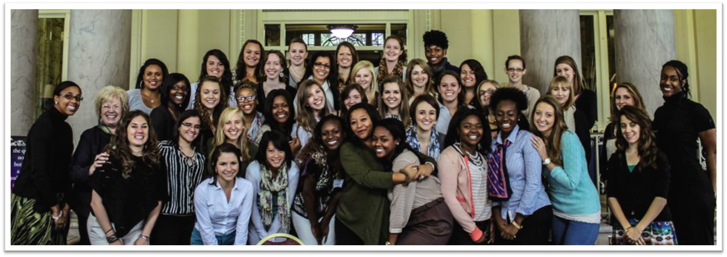
Like many things in life, you get out of VIH what you put into it. If you let it, this program will change you for the better!

