Slide 1
VIH Mentoring Program: CEE Guidance

Slide 2
CEE Reflections
Mentor: Describe your CEE
How did your group decide on a CEE topic?
How often did you meet with your group?
How often did your group speak with your campus coordinator?
How did your CEE Team market your CEE? Was it effective?
Did you develop relationships with people outside of your CEE Group during the CEE process?
If you had to do it over, how often would you meet with your group?

Slide 3
Think Globally
Watch this video: #STOPTHESHADE. What did the students do well in terms of choosing a topic?
Visit the Workshop Template page on the CEE Page of the VIH Website and review the Marketing Letter. How does this letter effectively communicate its message?

Slide 4
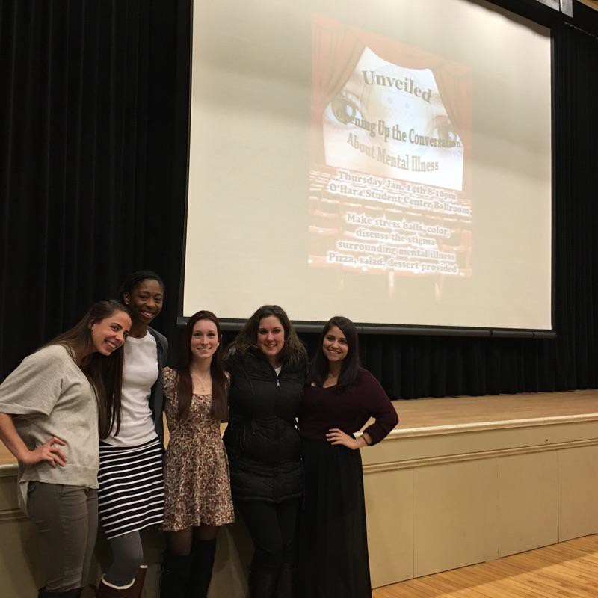
Act Locally
Watch this video: Hard Conversations. What did the students do well in terms of working as a team?
Visit the Cultural Performance template page on the CEE Page of the VIH Website and review the Marketing Letter. What aspects of the flyer make it attention grabbing and inviting? Where is a good place on your campus to place flyers?

Slide 5
Planning a CEE
Mentee: Start to brainstorm topics that you could potentially use for your CEE
You and the other Viras from your institution will have to work together to come up with a topic that meshes all of your ideas and international experiences
What stuck you most about the country you studied abroad in?
What made you uncomfortable or was different than what you are used to?
Use your experience report to help you brainstorm

Slide 6
VIH Website Resources
Visit the CEE Page of the VIH Website and review the Time Frame and General CEE Tools. Identify tools on this page that can help you with:
Scheduling a meeting with your group
Keeping track of meeting minutes
Deciding on a CEE Topic
Updating your campus coordinator
Inviting panelists to your CEE
Setting a date for your CEE
Developing marketing materials for your CEE

