Slide 1
VIH Program for Women in Global Leadership

Slide 2
Participating Institutions
Waynesburg
Lincoln
Robert Morris
Thiel
Temple
Arcadia
Chatham
Carlow
Duquesne
Pitt-Oakland
Pitt-Bradford
Pitt-Greensburg
Pitt-Johnstown
Washington & Jefferson

Slide 3
Leadership Development Retreat: Global
Cultural Simulations
Cultural Activities
Roundtable Discussions

Slide 4
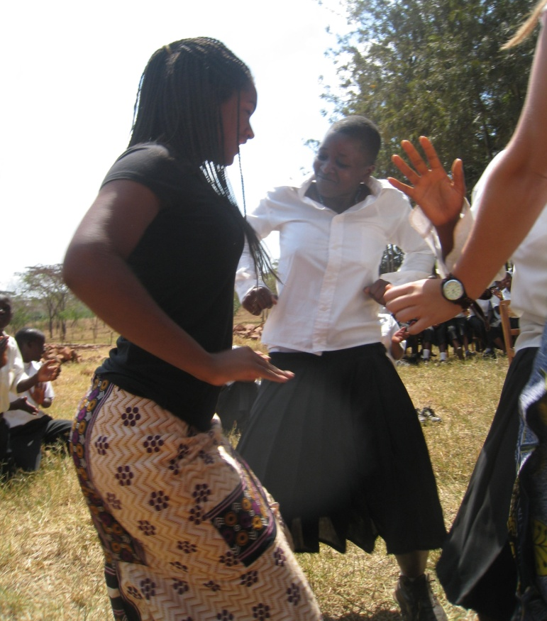
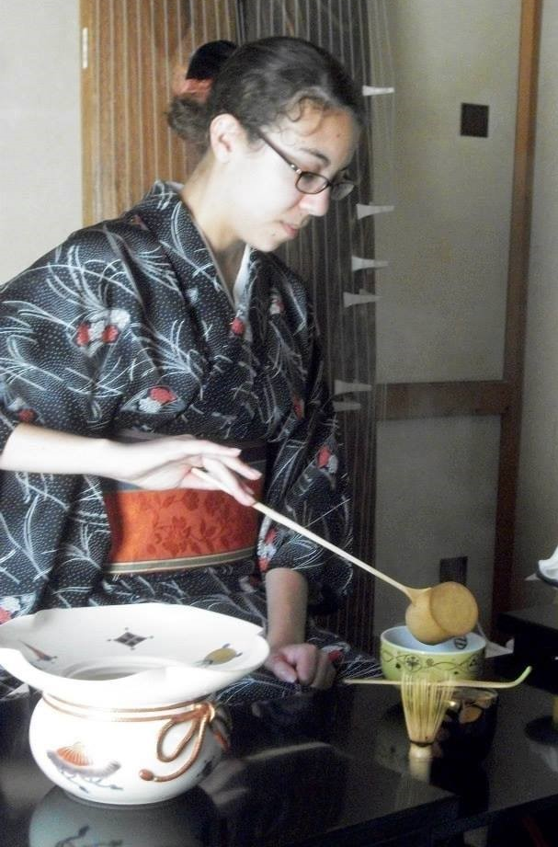
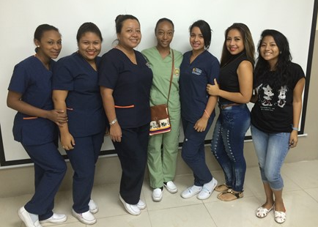
International Experience and Experience Report
Short Answer Questions
Budget
Photos

Slide 5
Leadership Development Retreat: Women
Developmental Experiences
Intersection of Gender and Leadership
Brainstorm CEE

Slide 6
Community Engagement Experience
Think Globally: Act Locally
Vision
Teamwork
New Initative

Slide 7
Contact Information
Dr. Sarah Wagner, VIH Director
sewst29@pitt.edu
viraheinz.pitt.edu

