Slide 1


VIRA I. HEINZ PROGRAM
FOR WOMEN IN GLOBAL LEADERSHIP
Notes:
Welcome!

Slide 2

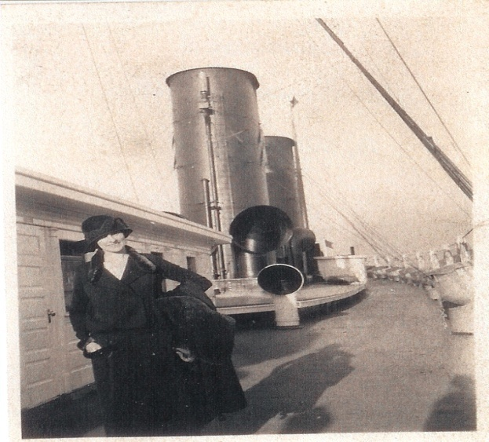
A Role Model for Women
The Transformational Impact of Foreign Travel

Slide 3
Participating Institutions
Duquesne
Pitt-Oakland
Pitt-Bradford
Pitt-Greensburg
Pitt-Johnstown
Washington & Jefferson
Robert Morris
Waynesburg
Lincoln
Carlow
Thiel
Temple
Arcadia
Chatham

Slide 4
Mission
        Develops global citizens and encourages a passion for life-long learning and civic engagement

Slide 5
Leadership Development Retreat: Global
    Cultural Simulations
    Cultural Activities
    Roundtable Discussions

Slide 6
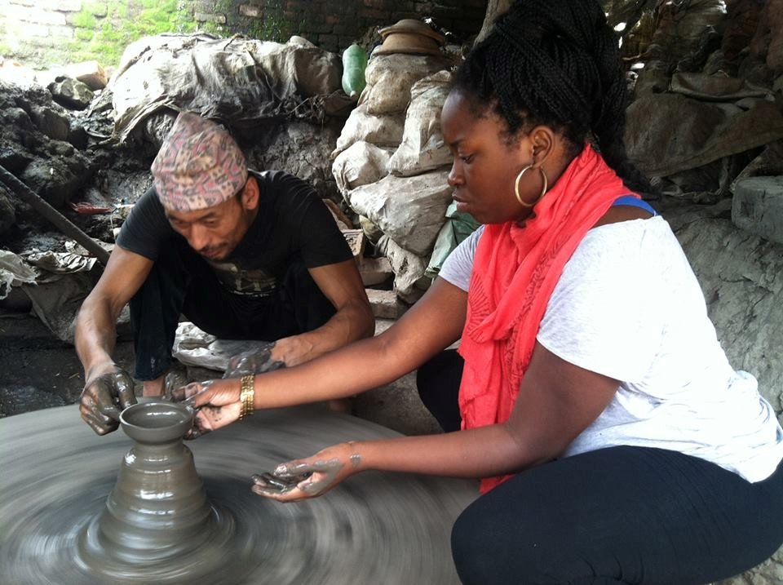
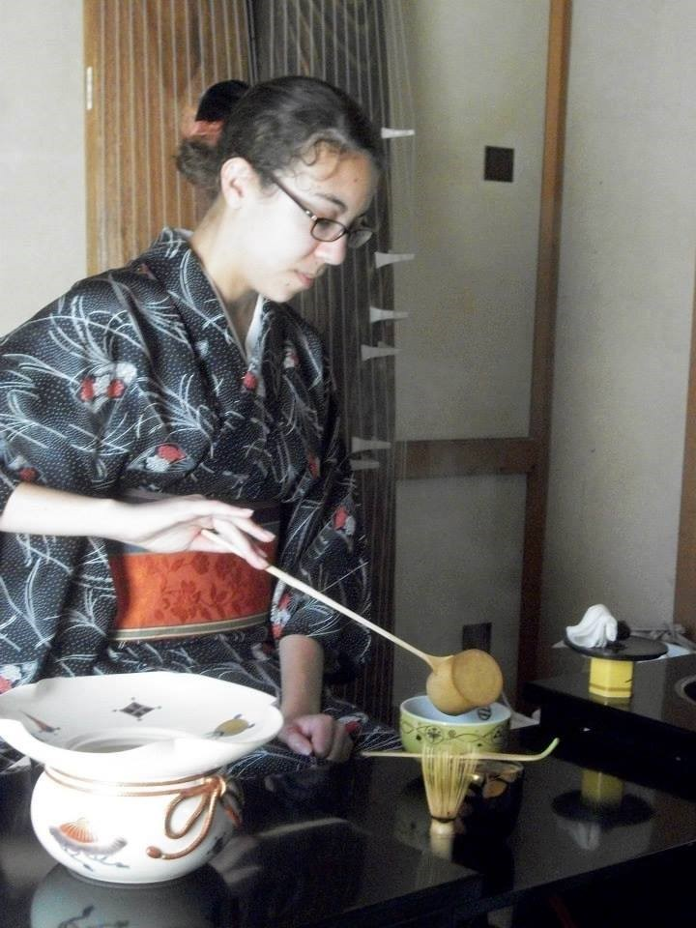
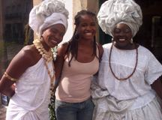
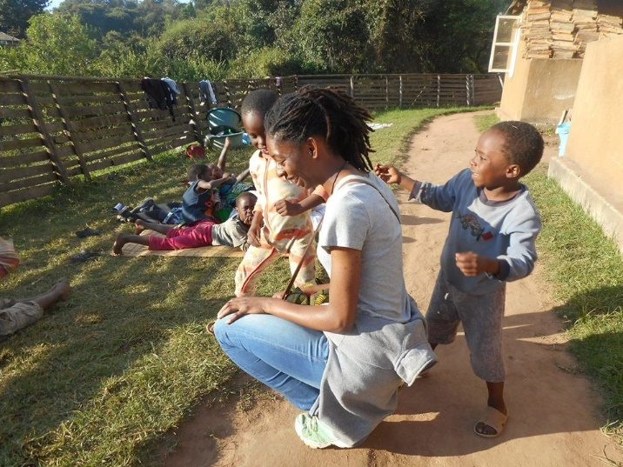
International Experience & Experience Report
Short Answer Questions & Paragraph
Budget
Photos

Slide 7
Leadership Development Retreat: Women
    Developmental Experiences
    Intersection of Gender & Leadership
    Brainstorm CEE

Slide 8
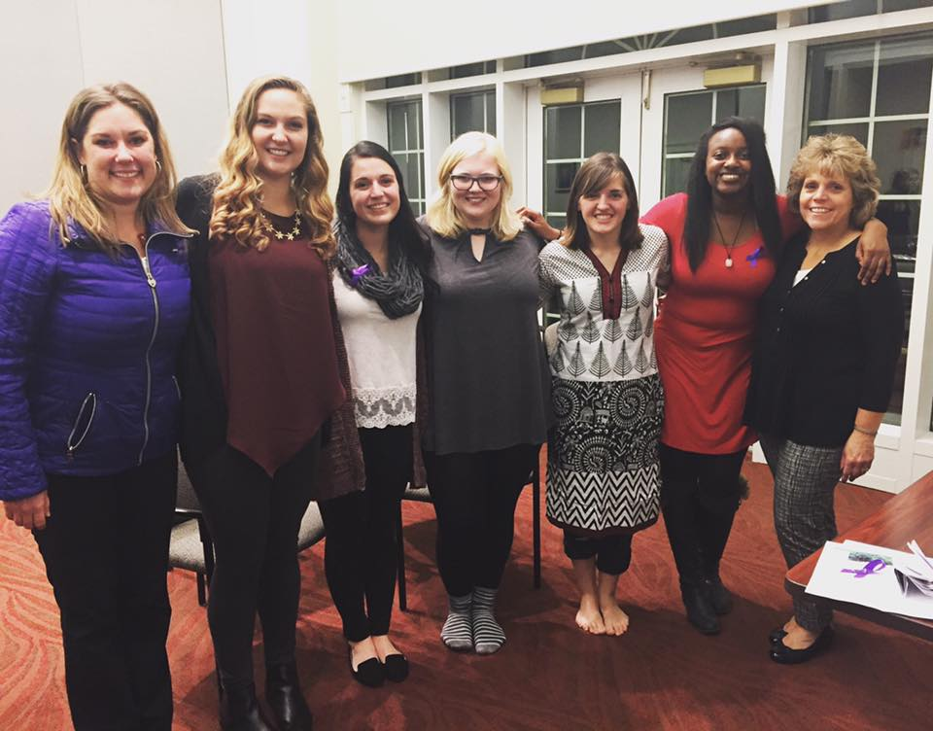
Community Engagement Experience
Think Globally; Act Locally!
Vision
Teamwork
New Initiative

Slide 9





Fundamentals of Leadership
Networking & Mentoring
Self-Knowledge
Valuing Others
Integrity
Accountability
Global Perspective
From a Woman’s Point of View…

Slide 10
Applicant Profile
No Previous International Experience
Open to Sophomores or Juniors
U.S. Citizen
Emphasis on Increasing Diversity

Slide 11
Regional Breakdown

Slide 12
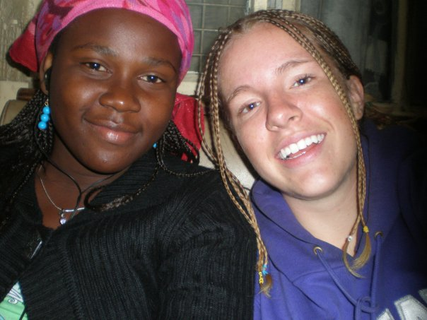
International Experience
Ruweidah
&
Jenn
“The thoughts and feelings associated with cultural immersion can be difficult to sort out without being prepared to understand these experiences… the VIH Program took me one step closer to figuring it out.”

Slide 13
Contact Information
Dr. Sarah Wagner, VIH Director
sewst29@pitt.edu
viraheinz.pitt.edu

