Slide 1
VIH Mentoring Program: Preparing for the International Experience
Notes:
Welcome! This is a multi-topic mentoring ppt. Feel free to select certain subtopics to cover during different sessions.

Slide 2
Cultural and Personal
Identity

Slide 3
Cultural and Personal Identity
What is Culture?
The total of the inherited ideas, beliefs, values, and knowledge, which constitute the shared bases of social action (World Dictionary, 2010).
The behaviors, beliefs, and characteristics of a particular social, ethnic, or age group (Dictionary.com, 2011).
The values, customs, and symbols associated with each society (DuBois & Miley, 2005).
Watch Video- How Culture Drives Behaviors
Notes:
Mentor and Mentee: Use this slide as a guide to discuss the concept of culture

Slide 4
Cultural Identity: 10 Cultural Clusters
These 10 Cultural Clusters are delineated by: language, religion, tradition, foods, clothing, recreation, education, and values
Anglo
Latin Europe
Germanic Europe
Nordic Europe
Eastern Europe
Confucian Asia
Southern Asia
Middle East
Sub-Saharan Africa
Latin America
In which cultural cluster will you study this summer? What do you know about the traits of this culture?

Slide 5
Personal Identity
Hispanic
Female
Transgender
African American
Scientist
Sister
I am…
Muslim
Agnostic
Lesbian
First-generation college student
Bisexual
Catholic
Working class
Deaf
Personal Identity describes you or is a significant part of who you are or how you identify yourself to others. What are some attributes that define your personal identity?
Notes:
Fill in the bubbles on the diagram above that define your personal identity. These could include things like: career/job, sexual orientation, ability, ethnicity or race, language speaking skills etc…

Slide 6
Cultural and Personal Identity
What is the difference between cultural identity and personal identity?
How has your cultural and personal identity shaped your worldview?
How can you respect someone’s culture while remembering that they are also an individual?
Notes:
Mentor and Mentee: Use this slide as a guide to discuss the difference between cultural and personal identity.

Slide 7
Interpersonal
Communication
Watch Video- Intercultural Communication

Slide 8
What is Interpersonal Communication?
Interpersonal Communication is the sharing of information across different cultures and social groups
We are always communicating. The very attempt not to communicate communicates something.
Verbal vs. nonverbal:
Verbal: words, tone of voice, verbal pauses
Nonverbal: gestures, emotion, body language, posture, facial expression, touch. 93% of interpersonal communication is non-verbal
Watch this video: Nonverbal Communication
Notes:
Interpersonal communication is an important tool to understanding cultures other than our own.

Slide 9
Communication is Contextual
Psychological: Who you are and what do you bring to the interaction?
This includes, your needs, desires, values, and personality.
Situational: Where are you communicating?
For example, an interaction that takes place in a classroom will be very different from one that takes place in a restaurant.
Environmental: What are your surroundings?
Think about the furniture, location, noise level, temperature, season, and time of day.
Cultural: What are the norms of behavior?
Think about learned behaviors and rules that affect the interaction. For example, if you come from a culture (foreign or within your own country) where it is considered rude to make long, direct eye contact, you will out of politeness avoid eye contact. If the other person comes from a culture where long, direct eye contact signals trustworthiness, then miscommunication can occur.

Slide 10
Discussion: Cultural Interpersonal Communication
Current Knowledge
What do you know about the communication styles in the country you are traveling to?
Think in terms of verbal and non-verbal communication.
Needed Knowledge
What do you still need to learn about in terms of interpersonal communication in your host country?
Are you aware of the ways in which you communicate nonverbally, and how will you go about enhancing your awareness of your own nonverbal communication style?
Action Plan
Before going abroad how will you learn about interpersonal communication in your host country?
Mentor, please share your experience with interpersonal communication during your study abroad experience.
Notes:
Mentee, share your current knowledge regarding your host country with your mentor. What do you still need to know? How will you continue to learn about your host country before your international experience? Mentor, please share any insight.

Slide 11
Goals & Action
Plans for Understanding Cultural Values

Slide 12
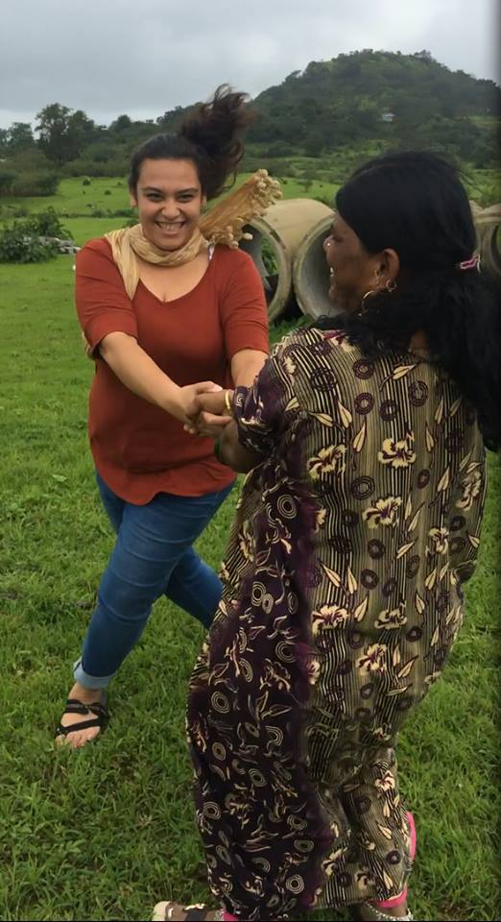
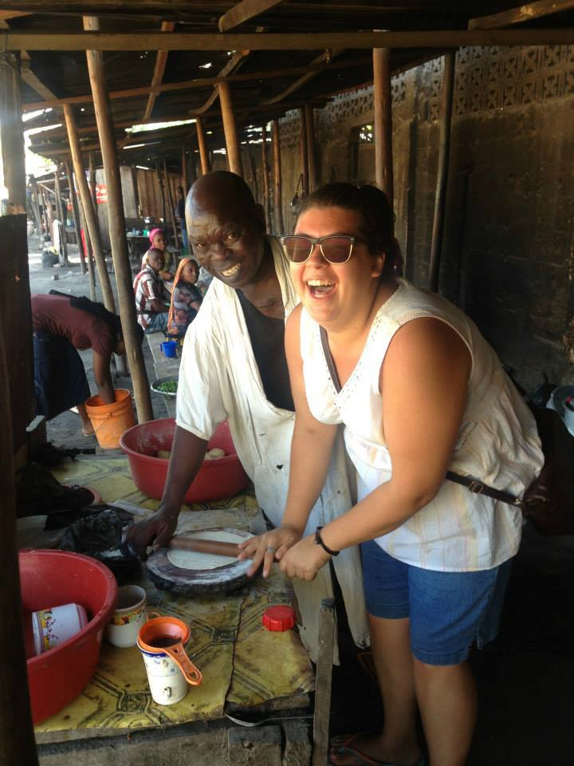
Discussion
What is the difference between a trip and an international experience?
Notes:
Mentor and Mentee, discuss the difference between a vacation and cultural immersion

Slide 13
Goals and Action Plans
Opportunity for you to articulate the impact you want to make in your study abroad country as well as what you want to get out of this experience, academically, personally, and professionally
Mentor: What did you accomplish while you were abroad?
Mentee: What do you want to get out of this experience?
Notes:
Mentor and Mentee, use this slide to have a discussion on goals and action plans. Mentee, we will discuss these in more detail at the spring VIH retreat.

Slide 14
Understanding Cultural Values
Understanding Cultural Values will allow you to:
Come into a deeper understanding of the culture, norms, and customs of your study abroad destination.
Gain a deeper understanding for your own personal strengths and weaknesses.
Develop new skills, in part, in order to adapt to your new environment.
Evaluate your life and the world from a different point of view.
Examine your own culture from a new perspective.

Slide 15
Understanding Cultural Values
Pay Attention
Keep an open mind and pay close attention to your physical surroundings
Take in the sounds and smells of your new environment, be observant to nonverbal communication, and observe the cultural interactions taking place.
Respectfully Engage
Talk with local people, get involved in cultural events, practice the language, and try the local food.
Avoid stereotyping.
Reflect Continuously
Take time to process what you are observing by: journaling, talking with a friend, talking with a faculty member, and by looking for connections between what you are personally experiencing and what you are learning about in class.

Slide 16
Culture Shock
Notes:
Welcome!

Slide 17
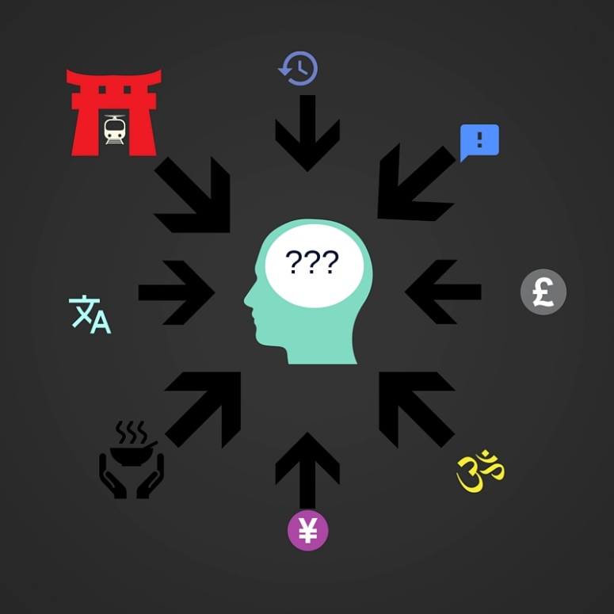
What is Culture Shock?
“The alienation, confusions, surprise, etc. that may be experienced by someone encountering unfamiliar surroundings, a strange city or community, or a different culture or experiencing interpersonal interactions that involve behaviors and/or values that are different from those engrained in one’s one culture.” Webster’s 3rd College Dictionary

Slide 18
Stages of Culture Shock
Pre-Departure: In the midst of packing and researching your host country, you feel a mixture of excitement and nervousness about your time abroad
Honeymoon: Upon arriving your host country, your excitement is through the roof! From taking photos to waiting for a bus, every moment seems like a thrilling adventure
Conflict: Several days or weeks into your international experience, you feel a sense of isolation and frustration with everyday tasks and differences between your home country and the host country
Adjustment: As your feelings of irritability subside, your host country begins to feel comfortable and you become oriented to your new way of life
Re-Entry: Upon your return to the U.S., readjusting to home life may seem difficult. You find that not only have you changed but your surroundings have changed as well

Slide 19
Culture Shock Coping Strategies
Remember that what you are going through is normal and will eventually pass
Try not to dwell on small incidents and problems
Reflect continuously
Keep a journal or blog
Talk with a friend or a person you can trust
Take care of yourself by getting lots of sleep and exercising
Use the resources your program provides you with
Explore and try to become comfortable with your new surroundings
Maintain a sense of humor
Make a plan to write an email or Skype your family/friends once a week

Slide 20
Discussion
Mentor:
What could you have done prior to leaving to better prepare yourself to deal with the new challenges of culture shock?
Mentee:
Think about who you are. Prior to going abroad, how will you prepare to deal with culture shock? What coping strategies will you employ abroad?
Talking with someone you trust can be a great way to cope with culture shock. Can you identify a few people in your life that you can have open discussions with?
Notes:
Use the slide above as a guide for a discussion on culture shock

Slide 21
Additional Resources
Visit the Pre-Departure Page of the VIH Website for additional resources:
https://www.viraheinz.pitt.edu/resources

