Slide 1
VIH Mentoring Program: Debriefing the International Experience
Notes:
Welcome! This is a multi-topic mentoring ppt. Feel free to select certain subtopics to cover during different sessions.

Slide 2
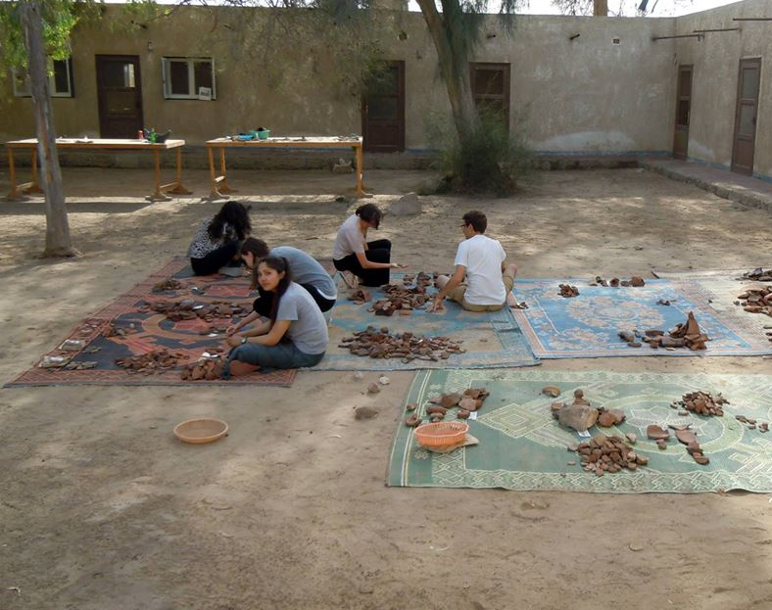
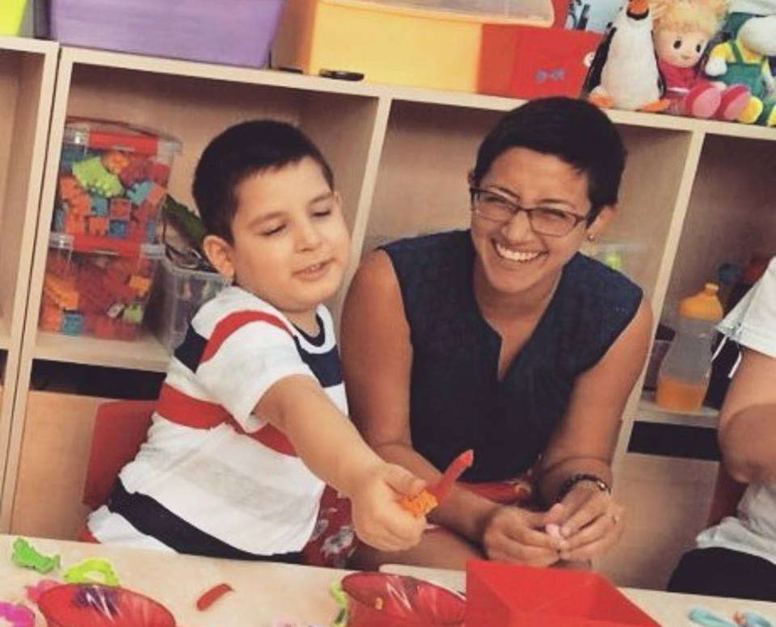
Welcome Back!
Mentee: Share stories and photos from your international experience
Notes:
Mentee: What did you learn about yourself through your international experience?

Slide 3
Stages of Reverse Culture Shock
Disengagement: This begins prior to leaving one’s host country. The acts of packing and saying good-bye to one’s new friends and host families may leave one feeling sad and frustrated
Initial Euphoria: This is the feeling of excitement associated with the idea of going home. This stage often ends when one realizes that one’s friends and family may not be as enthusiastic about his or her abroad experience as one hoped
Irritability and Hostility: This stage usually begins when one realizes that family members are not as willing as one hoped to hear the endless stories one wishes to tell about his or her time abroad. This may lead to feelings of loneliness, frustration, anger, hopelessness, and alienation. Many also struggle with the fact that they are not as independent at home as they were abroad.
Re-Adjustment and Adaptation: Most people are able to enter stage 4 to begin to re-adjust to a new out-look on US culture and way of life. This does not mean that one must forget all that he or she learned abroad, but one is able to adapt and apply these new ideas positively to his or her everyday life.

Slide 4
Coping with Reverse Culture Shock
Mentor: How did you cope with reverse culture shock? Share any advice you may have with your mentee.
Mentee: What, if any, has your experience been with reverse culture shock?

Slide 5
Goals and Action Plans
Mentee: What did you accomplish while abroad? Did your goals for your international experience change at all once you were in country?
Cognitive
Interpersonal
Intrapersonal

Slide 6
Experience Report
Mentee: What are the highlights of your Experience Report?
Mentor: How did you make the most out of the opportunity to discuss your Experience Report with your Campus Coordinator?

Slide 7
Pre-Retreat Assignments
International Fair Assignment
Mentor: What did you do for the international fair?
Mentee: Share your ideas for your international fair assignment
Interview with a Woman Leader
Mentor: Who did you interview? How did you decide on this person?
Mentee: Who would you like to interview? How will you go about approaching this person?

Slide 8
Additional Resources
Be sure to refer to the VIH Website for additional resources
Experience Report: https://www.viraheinz.pitt.edu/scholars/experience-report
Fall Retreat: https://www.viraheinz.pitt.edu/scholars/retreats/fall-retreat
Re-Entry: https://www.viraheinz.pitt.edu/content/re-entry-opportunities

